Slide 1

TEXT SUMMARIZATION USING NLP
TEAM - 2
1. Adithya Harsha
2. Chethan Kumar
3. Ashwini rai
MENTOR :- Munmun Ma’am DATE :- 24-05-2022

Slide 2
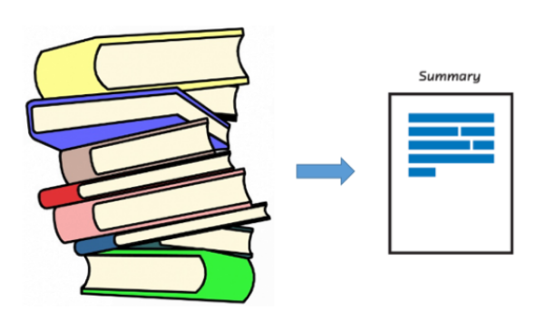
INTRODUCTION :-
The Goal of Summarization is to produce a shorter version of a source text by preserving the meaning and the key contents of the original Book.
A well written summary can significantly reduce the amount of work needed to digest large amount of text.

Slide 3
BUSINESS PROBLEM :-
Text summarization is one of the most interesting problems in NLP. It’s hard for us, as humans, to manually extract the summary of a large document of text. To solve this problem, we use automatic text summarization. It’s a way of identifying meaningful information in a document and summarizing it while conserving the overall meaning.
OBJECTIVE :-
The purpose is to present a shorter version of the original text while preserving the semantics. Here, you can use different traditional and advanced methods to implement automatic text summarization, and then compare the results of each method to conclude which is the best to use for your corpus.

Slide 4

DATA INFORMATION : -
Book Name :- The Alchemist
Author :- Paul Coelho
Source :- Google
Pages :- 158

Slide 5
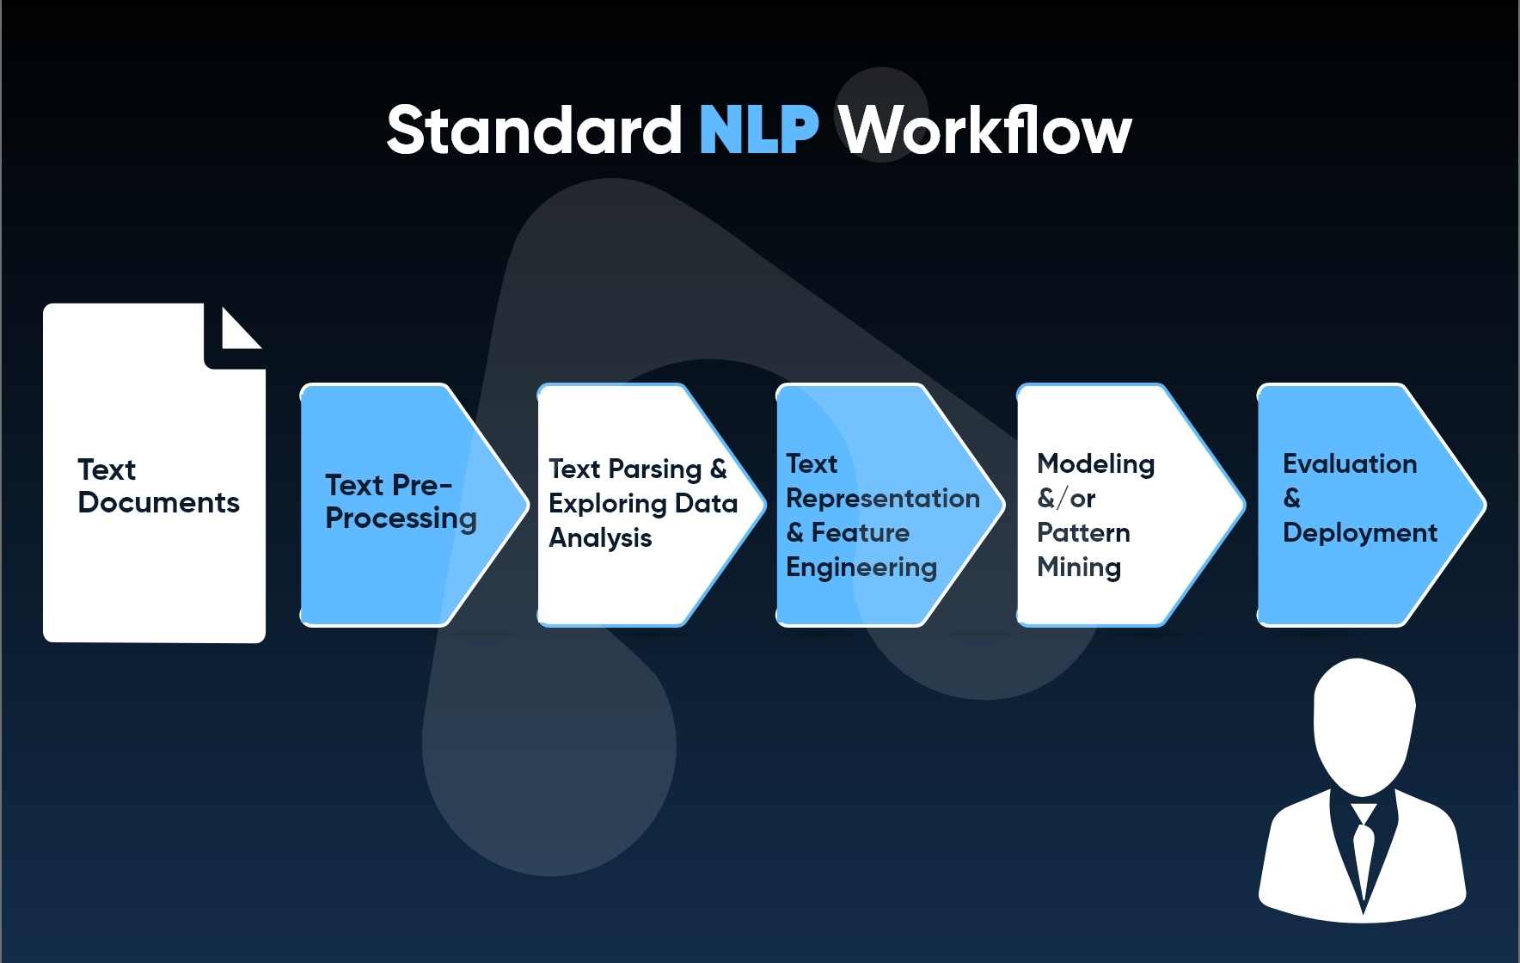
PROJECT ARCHITECTURE :-

Slide 6
EXPLORATORY DATA ANALYSIS ( EDA)
EDA is the basic step of the project. Before performing operations on the data, we need to clean the data.
In text summarization , EDA can be done to remove the stopwords
and punctuations in the text data.
EDA Consists of following steps :-
Tokenization
Stopwords Removal
Punctuation Removal
Stemming
Lemmatization

Slide 7
TOKENIZATION
Tokenization is used to divide the text data into words or sentences.
Tokenization is done by two ways :-
a) Word based tokenization
b) Sentence based tokenization
We tokenized our data in the form of word based tokenization.
We are using the NLTK library of python.

Slide 8
PUNCTUATIONS REMOVAL
For data processing data should be cleaned so we need to remove the punctuation from the data.
Punctuations are often unnecessary as it doesn’t add value or meaning.

Slide 9
STOPWORDS REMOVAL
Stop words are most common words in any language that do not carry any meaning and are usually ignored by NLP
Examples of stop words :-
ON ,A ,THE ,IS ,ARE ,I ,FOR ,YOU ,AND ,IN

Slide 10
FEATURE EXTRACTION TECHNIQUE
Feature extraction techniques are used to convert text into a vecor.
It assigns different weights to words.
Types of feature extraction techniques are as follows :-
a) Bag of words (BOW)
b) TF-IDF
c) Word Embedding

Slide 11
STEMMING & LEMMATIZATION
Stemming and lemmatization both are text reduction techniques.
Using stemming and lemmatization we reduce the text can size.
In stemming the suffix and prefix of the word is removed irrespective of meaning.
In Lemmatization the suffix and prefix of the word is removed by maintaining the semantic of the word.

Slide 12
BAG OF WORDS (BOW)
BOW is the simple representative of the words.
Representation of text describes the occurrence of words within the document.
Generally it count the frequency of words that are repeated in the given document.

Slide 13
TERM FREQUENCY- INVERSE DOCUMENT FREQUENCY( TF-IDF)
TF calculates the frequency of the word in given document divided by the total words in the document.
TF = No. of words in the document / Total count of words in the document.
IDF calculates the frequency of the words on the total document.
IDF = Total no. of documents / No. of documents with word in it.
Weight= TF*IDF
So in this way weights are assigned to the words & is more semantic
than the BOW.
Higher weight is assigned to the most repetitive words so it is considered as less significant.

Slide 14
WORD EMBEDDING
Word embedding is used for the representation of the word for text analysis.
The most used type of word embedding is Word2Vec.
Each word is basically represent as vector of 32 or more dimension instead of the single word.
Here semantic information & relation between word is also preserved.
Word2Vec assigns nearby vector according to the class.

Slide 15
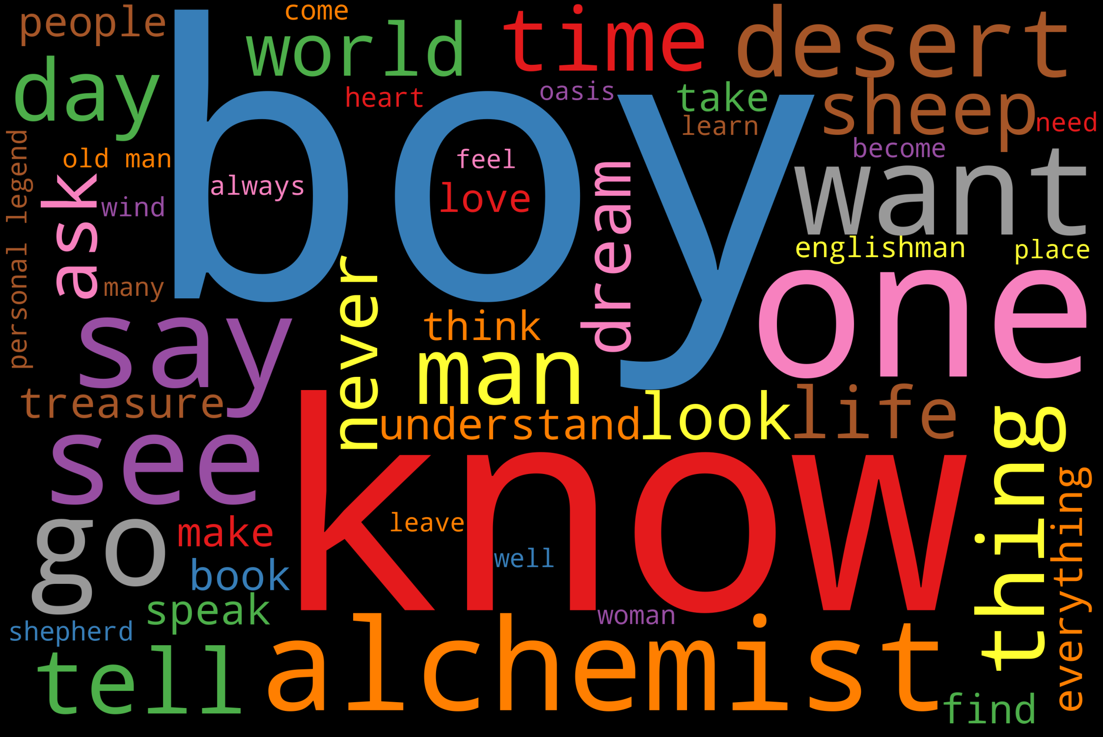
WORD CLOUD

Slide 16
MODEL BUILDING
We used pretrained models for text summarization and they are as follows :-
1) Lex rank
2) Luhn model
3) LSA model
4) Text rank
5) Bart model

Slide 17
TEXT SUMMARIZATION
Text summarization are of two types
1) Extractive Text summarization :-
Extractive summarization picks up sentences directly from the document based on a scoring function to form a coherent summary. This method word by identifying important sections of the text and crops out and stitches together portions of the content to produce a condensed version.
Example :- Text Rank, Luhn, LexRank , LSA etc.

Slide 18
2) Abstractive Text summarization :-
Abstractive summarization methods aims at producing summary by interpreting the text using advanced natural language techniques in order to generate a new shorter text parts of which may not appear as part of the original document. Abstractive text summarization generates
text with respect to the surrounding text.
Example :- LSTM, RNN, BERT, Transformer BART etc.

Slide 19
LEX RANK
LexRank is an unsupervised graph based approach for automatic text summarization.
In this model we have a connectivity matrix based on intra-sentence cosine similarity which is used as the adjacency matrix of the graph representation of sentences.
With the help of cosine similarity scored sentences are extracted from the document and are arranged in order.

Slide 20
LUHN TEXT SUMMARIZATION
Luhn’s algorithm is a naive approach based on TF-IDF and on “window size”
of non-important words and between words of high importance.
It also assigns higher weights to sentences occurring near the beginning of a document.
It is useful when very low frequent words as well as highly frequent words(stop words) both are not significant. Based on this, sentence scoring is carried out and high ranking sentences
make it to the summary.

Slide 21
LSA TEXT SUMMARIZATION
Latent Semantic Analysis is an unsupervised learning algorithm that can be used for extractive text summarization. It extracts semantically significant sentences by applying singular value decomposition (SVD)
to the matrix of term-document frequency.

Slide 22
TEXT RANK
TextRank uses an extractive approach and is an unsupervised graph based text summarization technique. PageRank is an algorithm used to calculate rank of web pages, and is used by search engines such as Google. TextRank is based on the PageRank Algorithm.
It finds the similarities between sentences and then organizes in descending order.

Slide 23
BART MODEL
BART is a sequence - to - sequence model trained as a denoising autoencoder. This means that a fine - tuned BART model can take a text sequence as input and produce a different text sequence at the output. The idea here will be to use all the weights of the pretrained neural network model and use it as a initial point, in order to speed up training and improve performance.

Slide 24
MODEL EVALUATION
ROUGE-N MEASURE
Rouge measure the number of common N-grams between the generated summary and the original text.
With the help of this we measure PRECISION, RECALL and FI-Score

Slide 25
MODEL EVALUATION RESULT
Conclusion :- LSA model gives high FI-Score we choose LSA model for deployment.
LSA
0.15117
1
0.2626
Score | LexRank | Luhn | LSA | TextRank | BART
Recall | 0.08484 | 0.11191 | 0.15117 | 0.06859 | 0.0909
Presicion | 1 | 1 | 1 | 1 | 0.2647
F-score | 0.1564 | 0.2012 | 0.2626 | 0.1283 | 0.1353

Slide 26
MODEL DEPLOYMENT
With the help of ROUGE score we choose our LSA model for the deployment. As LSA model gives high FI-Score value i.e 0.2626.
We deployed our model with the help of streamlit.
Streamlit is an open-source app framework for creating and deploying data science applications.
We deploy our model in anaconda prompt.

Slide 27

MODEL DEPLOYMENT

Slide 28
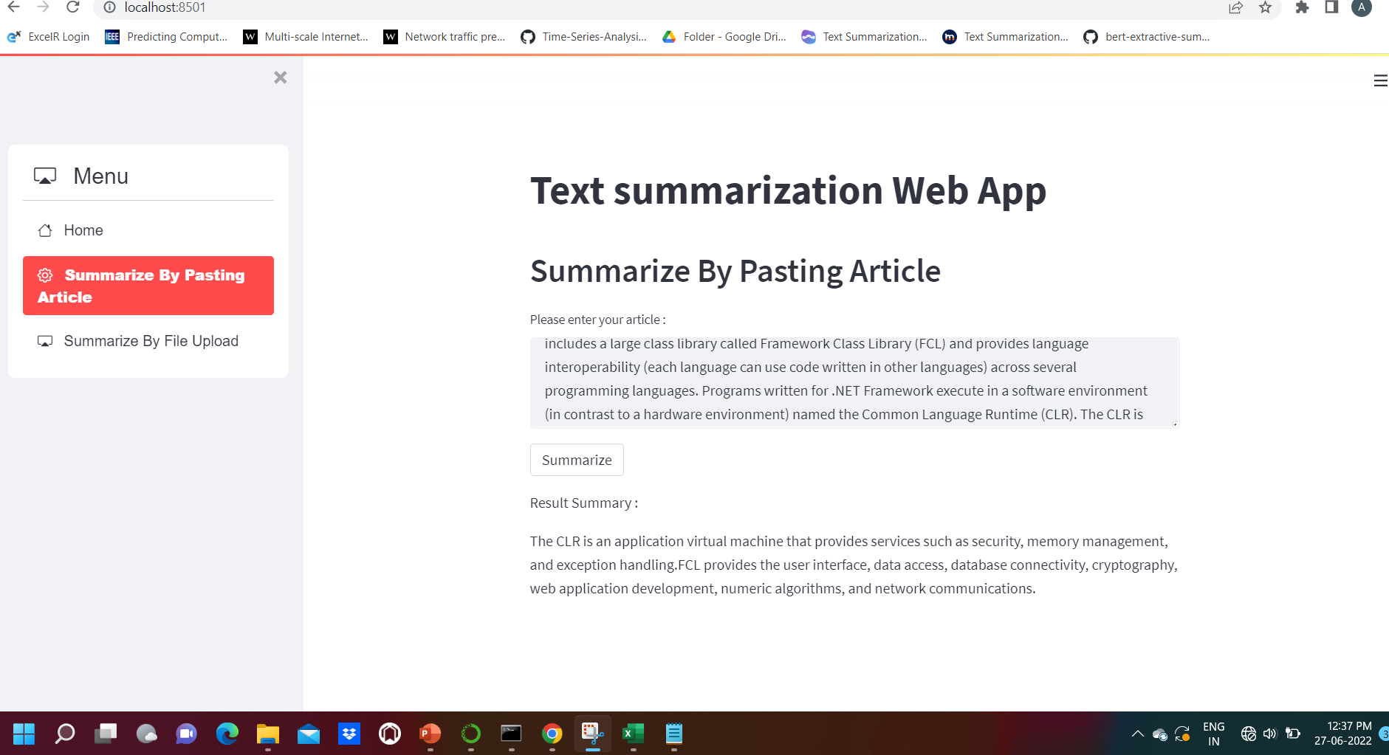
MODEL DEPLOYMENT

Slide 29
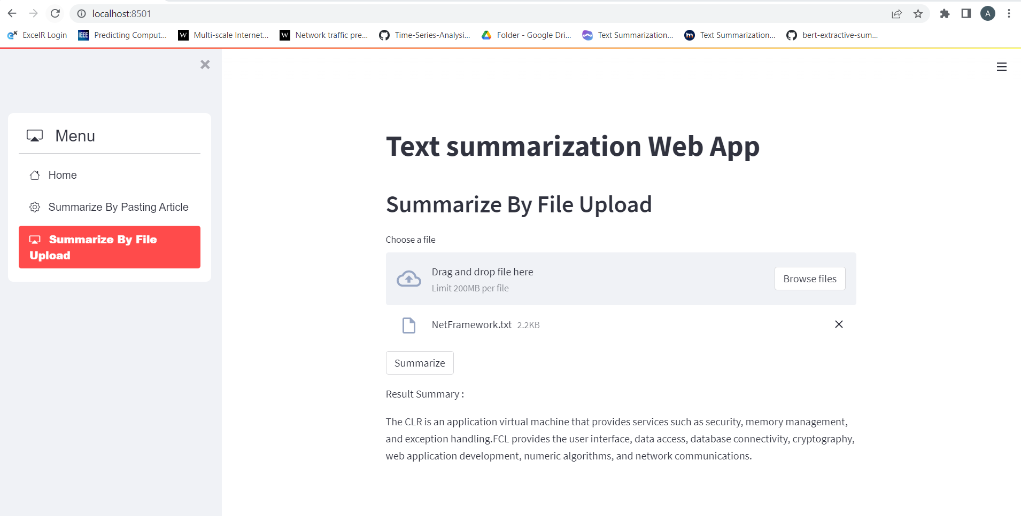
MODEL DEPLOYMENT

Slide 30
CHALLENGES FACED ?
Removing Unnecessary things from the text file
Choosing the better model
HOW DID WE OVERCOME
Exploratory data analysis
Compare the accuracy of all the models

Slide 31
Thank You

